Slide 1
January 2025 Webinar
Sexual Cyberbullying & Healthy Romantic Relationships: Activate’s Sexual and Reproductive Health Resources
Presenters:
Rachel Rosenberg, Ph.D., Samuel Beckwith, Ph.D. and Karlee Naylon
Child Trends

Slide 2
Technical Questions
If you cannot hear this presentation, please exit the webinar and opt to call in on your phone, as this can solve most audio problems.
Locate the “hand” on your GoToWebinar control panel to indicate if you are new to Dibble webinars.
You will find handouts and the questions box located in your control panel.

Slide 3
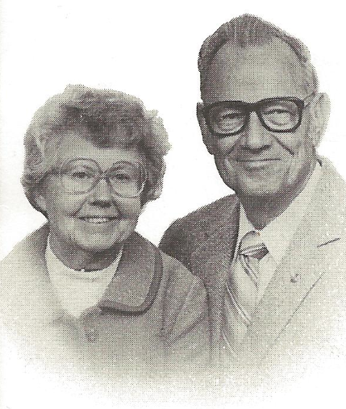
Charlie and Helen Dibble

Slide 4
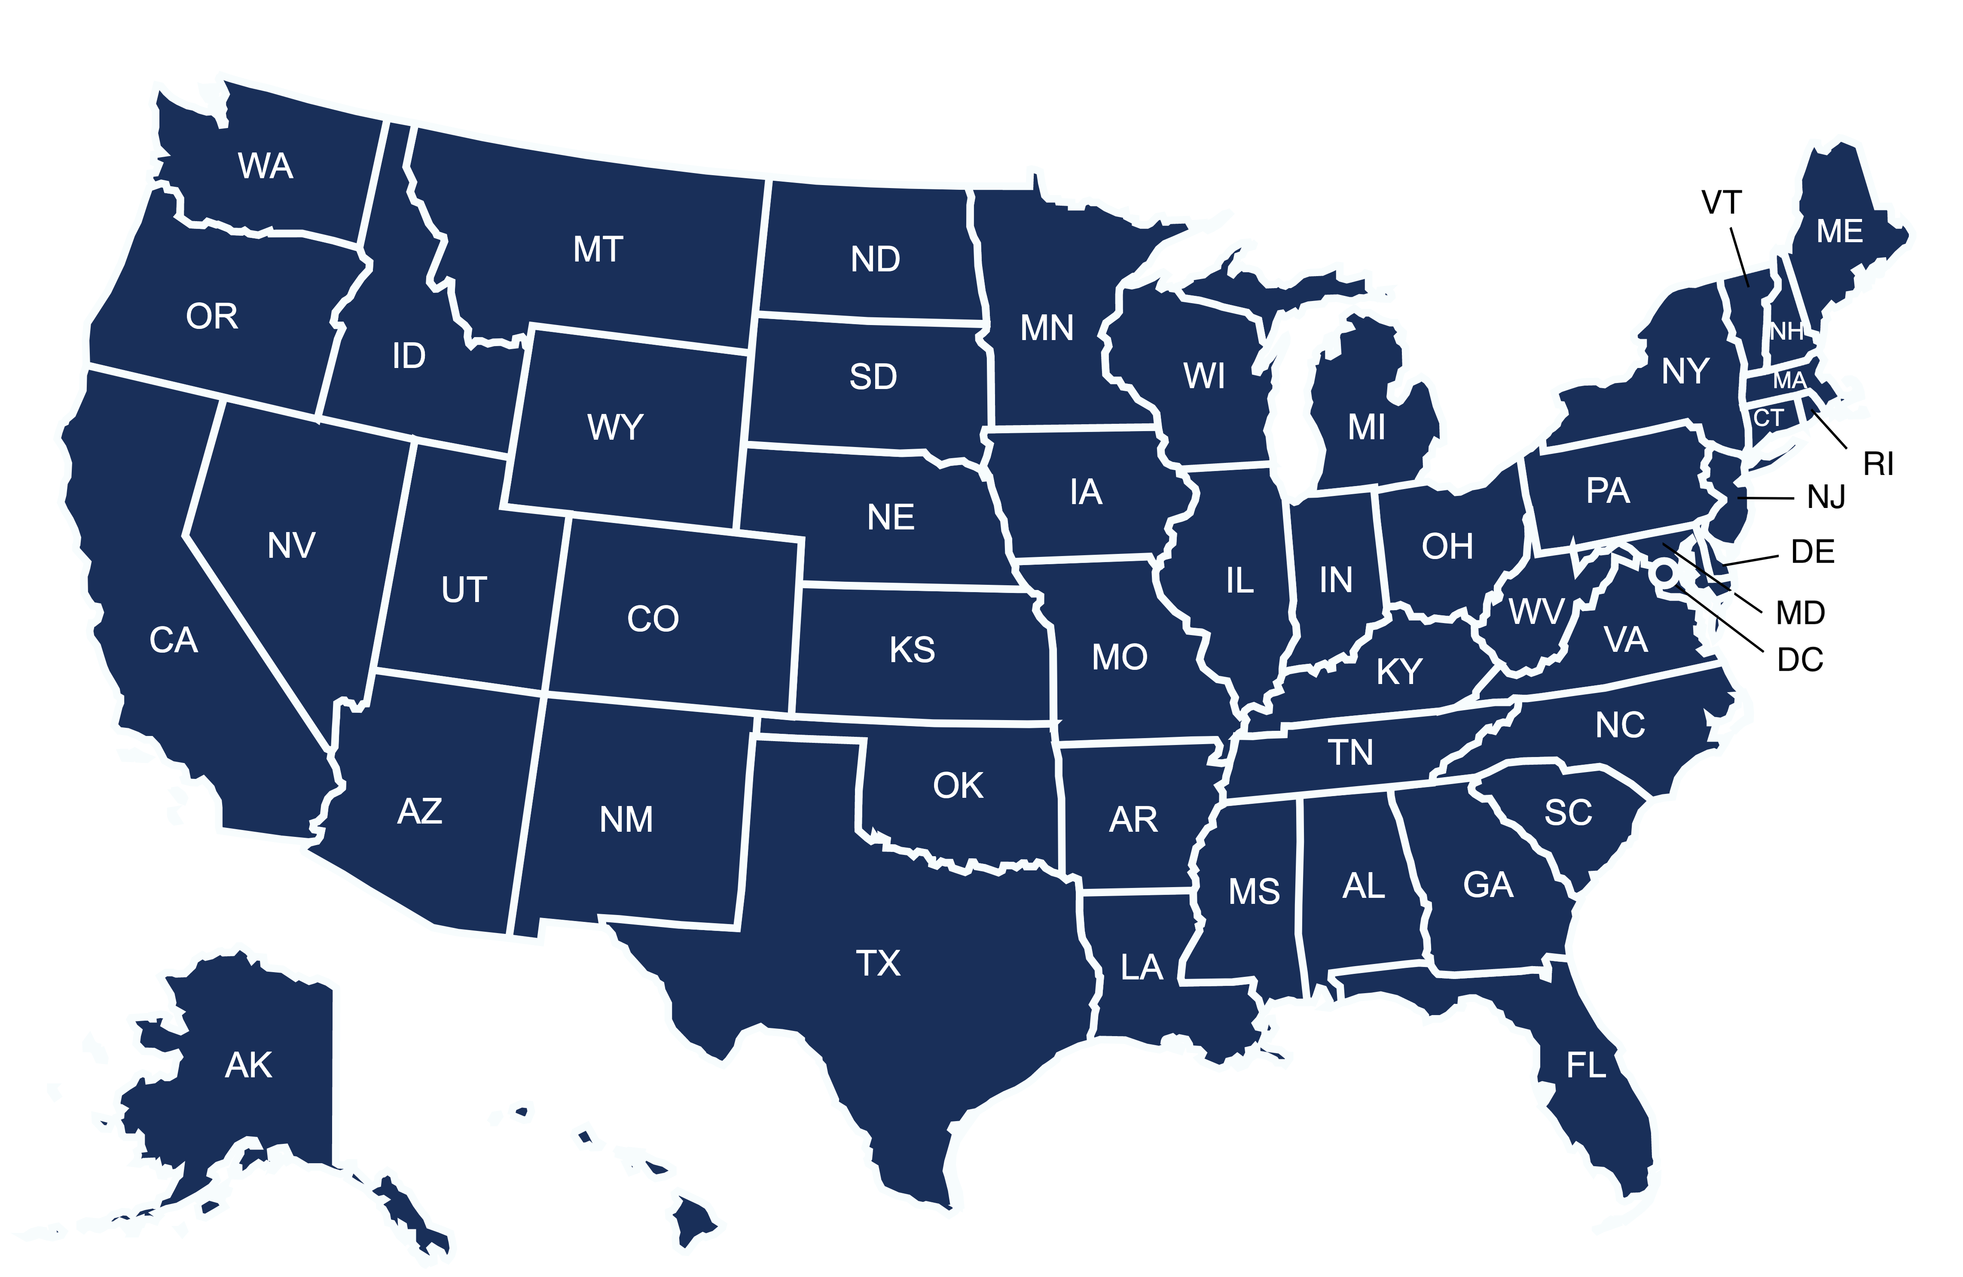
The Dibble Institute is a national, independent non-profit organization.
2022-2023 Clients
serving over 126,000 youth

Slide 5
Our Mission
Empowering teens and young adults with knowledge and
research-based skills
to successfully navigate
their intimate relationships.

Slide 6
We believe in research.

Slide 7
We believe in stable, safe, and nurturing families.

Slide 8
We believe that relationship education is for everyone.

Slide 9
Sexual Cyberbullying & Healthy Romantic Relationships: Activate’s Sexual and Reproductive Health Resources

Slide 10
Learning Objectives
Understand the forms sexual cyberbullying may take and how youth-supporting professionals may be resources for young people experiencing it;
Recognize the components of healthy relationships and strategies for discussing healthy relationships with young people;
Identify helpful resources from the Activate Center on these and other topics.

Slide 11
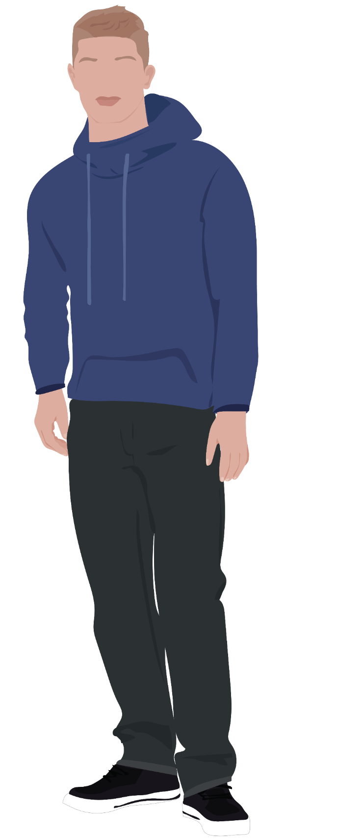
Activate partners with youth-supporting professionals, young people, and researchers to translate research and create research-based resources for professionals who support young people experiencing the child welfare and/or justice systems, homelessness, and/or disconnection from school and work (i.e., opportunity youth).

Slide 12
Five Steps to Translate Research to Practice
Identify
Identify the need and opportunity for research translation
Summarize Knowledge
Summarize and synthesize available knowledge
Make Research Actionable
Apply knowledge to practice
Train
Build capacity, using research-based practices
Collect & Curate
Collect, review, and organize existing information

Slide 13
Sexual Cyberbullying Resources

Slide 14
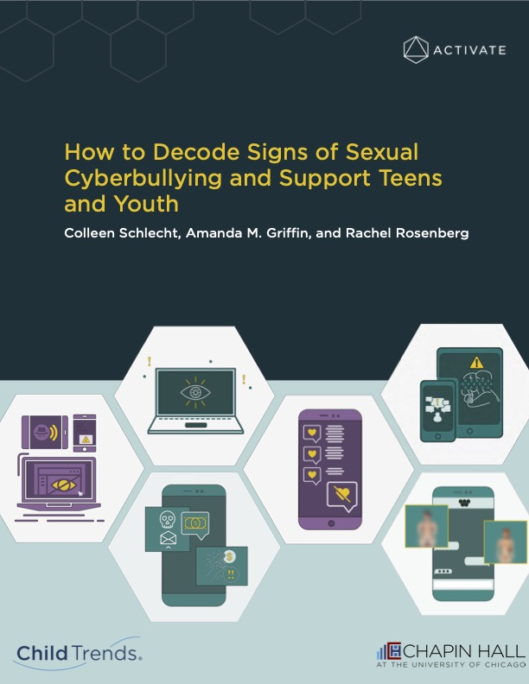

Slide 15
Identifying a Need: Sexual Cyberbullying
Limited available resources on sexual cyberbullying among Activate’s populations
Definitions and use of sexual cyberbullying are inconsistent
Lack of research on sexual cyberbullying behaviors

Slide 16
Identifying a Need: Sexual Cyberbullying
Sexual cyberbullying comes up often when talking with youth.
Staff need more information about social media platforms and sexual cyberbullying behaviors.
Youth do not use our terms when talking about sexual cyberbullying.
Sexual cyberbullying behaviors need to be explained to youth by staff.

Slide 17
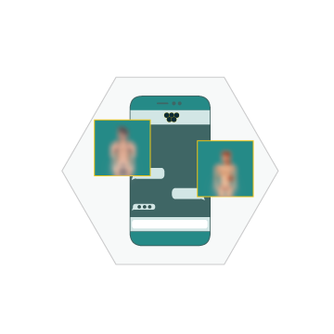
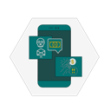
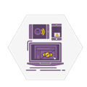
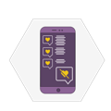
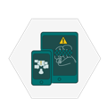
Sexual Cyberbullying: What Is It?
Sexual cyberbullying is a broad term used to describe any sexually aggressive or coercive behavior facilitated by technology to intentionally harm, embarrass, threaten, or intimidate another person.
Revenge porn
Sextortion
Online Sexual Harassment
Cyberstalking
Nonconsensual sexting
Cyberdating abuse

Slide 18
Sexual Cyberbullying: What Is It?
Sexual cyberbullying is a broad term used to describe any sexually aggressive or coercive behavior facilitated by technology to intentionally harm, embarrass, threaten, or intimidate another person.
Sextortion: Receiving or sending a message claiming that an explicit image will be shared online unless one complies with the sender’s request
Revenge porn: Distributing photographs or videos of an ex-partner, obtained via hacking or other methods.
Online Sexual Harassment: Receiving or sending an unsolicited message on Instagram asking about what someone likes/is into sexually
Cyberstalking: Receiving/sending messages through a social media platform that one is being watched
Nonconsensual sexting: Receiving or sending a naked picture on Snapchat without consent
Cyberdating abuse: Finding hurtful comments about one’s body on a partner’s Instagram post

Slide 19
Sexual Cyberbullying Research Summary Sections
Prevalence
Definitions
Prevention
Laws on sexual cyberbullying
Available resources
Risk and protective factors

Slide 20
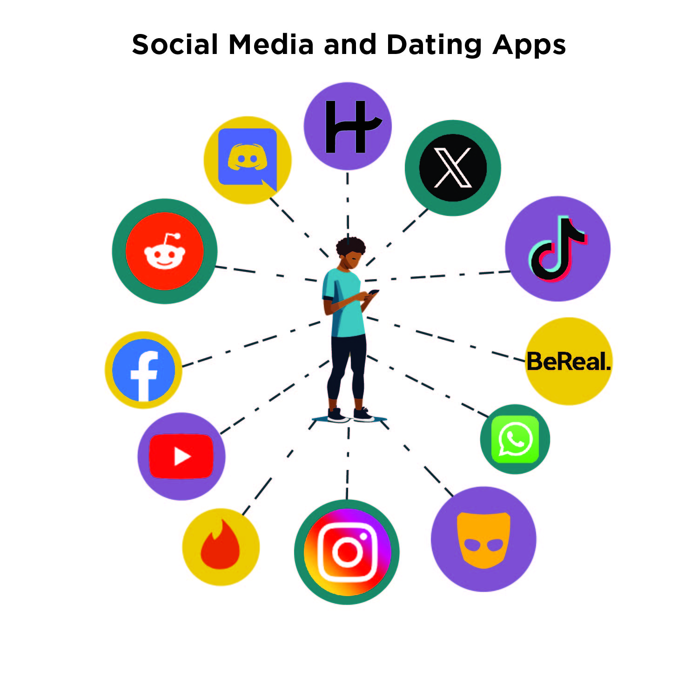
Where Does Sexual Cyberbullying Happen?
Sexual cyberbullying can occur through:
Email Instant messaging Text messaging Public posts and direct messages

Slide 21
What Are The Signs of Sexual Cyberbullying?

Slide 22
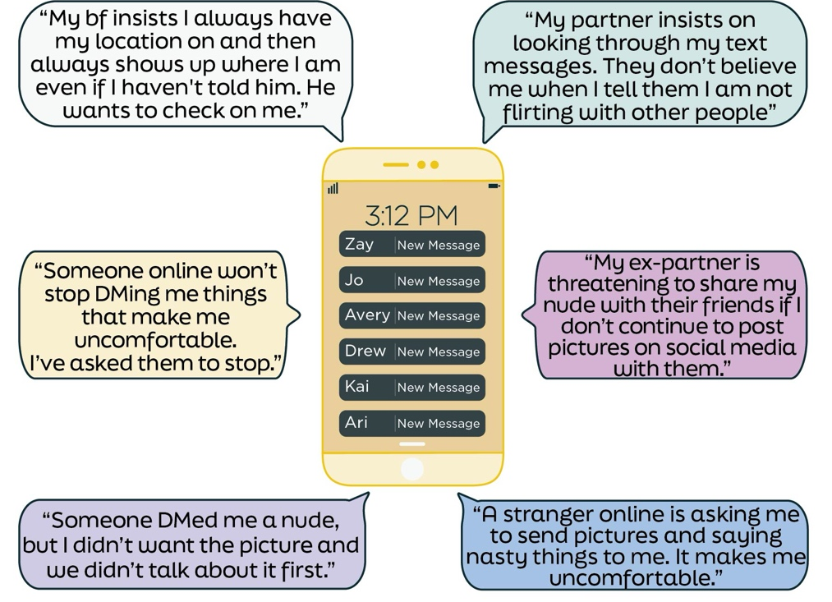
What Might Youth Experiencing Sexual Cyberbullying Say?
Examples include vernacular terms/slang that young people may use:

Slide 23
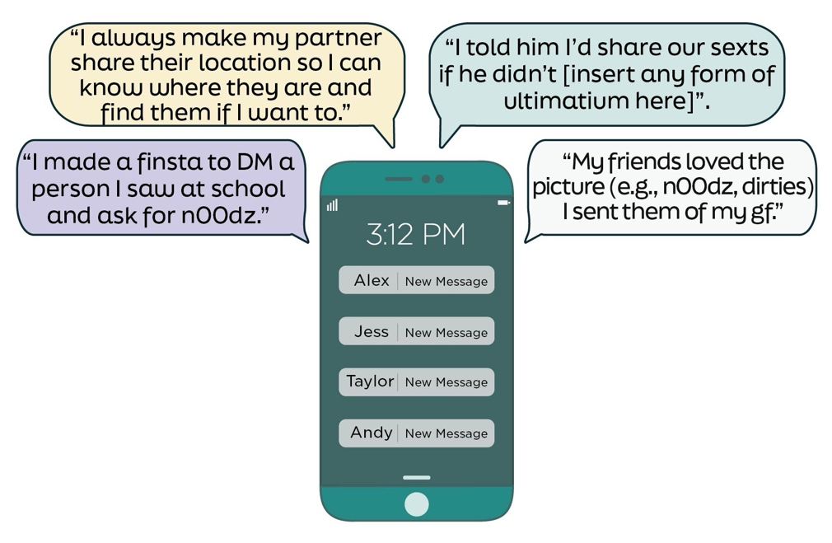
What Might Youth Who Are Engaging in Sexual Cyberbullying Say?
Examples include behaviors young people may talk about without realizing they are sexual cyberbullying others:

Slide 24
Recommendations for Providers
Talk about online platforms and sexual cyberbullying with young people.
Learn about sexual cyberbullying laws within your state.
Inform young people about how consent relates to online behavior.
Support young people who have experienced sexual cyberbullying.
Connect youth with local services.

Slide 25
Healthy Romantic Relationships

Slide 26
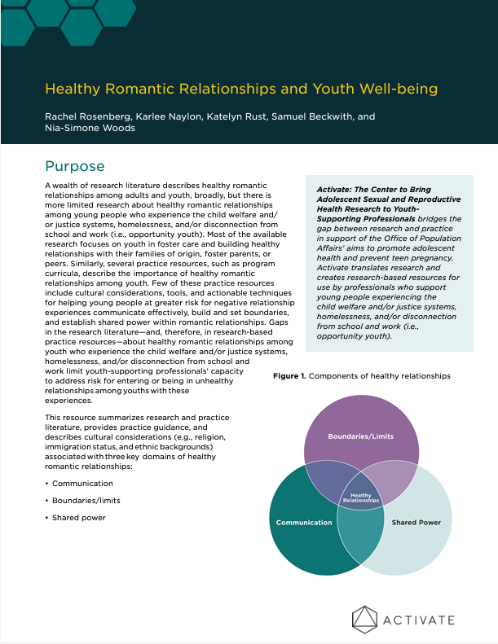
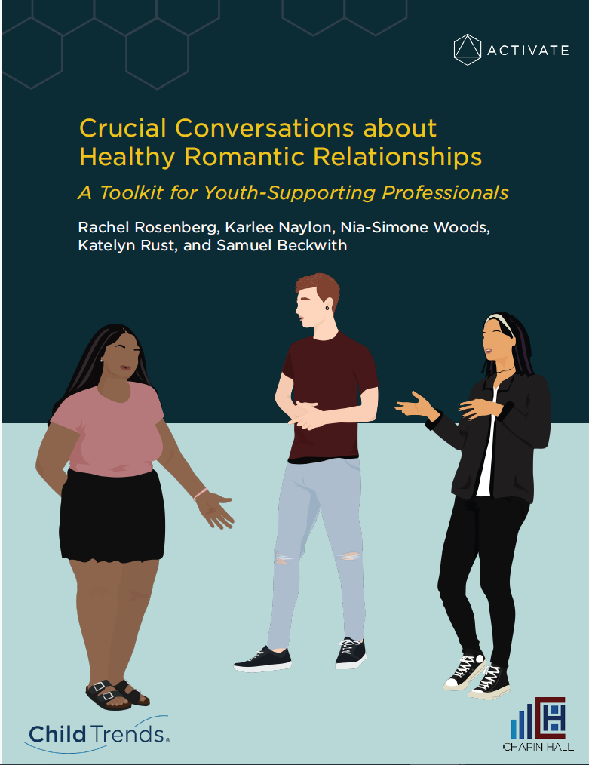

Slide 27
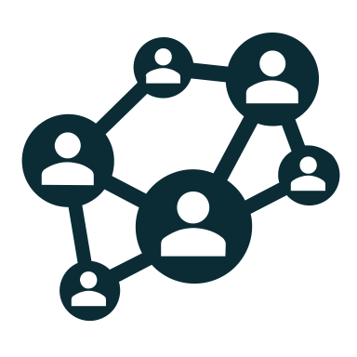
Identifying a Need: Healthy Romantic Relationships
Vulnerable populations are at a higher risk of unhealthy relationships.
Current research and resources focused on preventing unhealthy relationships.
Youth and professionals noted the importance of communication, boundaries/limits, and shared power.
There is a lack of information on how to form a healthy relationship.

Slide 28
Identifying a Need: Healthy Romantic Relationships
Healthy romantic components are based on guidance from professionals who support young people and young people themselves.
Highlight the importance of cultural and systemic differences.
Provide youth-supporting professionals tangible tips for implementing the information with young people.

Slide 29
Components of Healthy Romantic Relationships
Communication: allows one person to share how they are feeling or what they think with their partner(s).
Boundaries/Limits: helps youth express to their partner(s) what conditions they need to feel content and safe in a relationship.
Shared Power: requires a balance of support and responsibilities between partner(s).

Slide 30
Overlap in Components of Healthy Romantic Relationships
Boundaries/Limits and Communication: healthy communication is needed to set and enforce boundaries.
Boundaries and Shared Power: boundaries can help partners understand how to share responsibility in relationships and work toward equity.
Communication and Shared Power: in relationships with shared power, partner(s) communicate to establish balanced responsibility/needs/wants.

Slide 31
Systemic and Cultural Considerations
Use of nonverbal communication and communication styles
Views about autonomy and independence within a relationship
Societal bias against LGBTQ+ relationships, racism, and gender roles

Slide 32
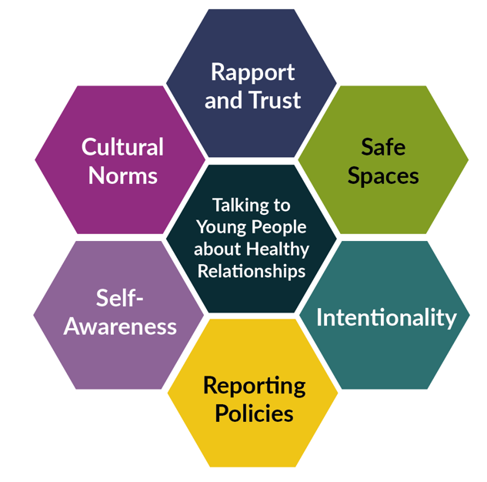
Laying the Foundation to Talk to Young People About Healthy Relationships
You can establish the foundation for talking to young people about healthy relationships when you:
Develop rapport and trust with the young person.
Create a welcoming and private space.
Prepare for, engage in, and follow up with youth intentionally.
Remain self-aware and willing to reflect on your own assumptions.
Maintain your knowledge of state-mandated reporting policies.
Pay attention to cultural norms.

Slide 33
Conversation Starters: Communication
Active listening
Getting started | What does active listening look like to you? In other words, how does someone show that they are really listening to you?
Continuing discussions | How would you approach a discussion with your partner(s) if you wanted them to listen to you more actively? Have you and your partner(s) discussed words or actions that signal you are actively listening to one another?
Following up | How have you and your partner(s) used active listening since we last spoke?

Slide 34
Conversation Starters: Boundaries/Limits
Establishing boundaries/limits
Getting started | When you and/or your partner(s) set a boundary or limit, how do you show you respect that limit?
Continuing discussions | What is an example of a boundary/limit that you set and your partner respected? How comfortable are you talking to your partner(s) about boundaries/limits you want them to better respect? What helps you feel more comfortable with setting a boundary or limit? What does considering your partner(s)’ boundaries/limits look like to you?
Following up | Since we last spoke, what boundaries have you set with your partner and how were those boundaries respected?

Slide 35
Conversation Starters: Shared Power
Input in decision making
Getting started | What are some examples of the input you have or want to have when making decisions?
Continuing discussions | When you are having a conversation or making a decision with your partner(s), what kind of input do you want to have? How comfortable are you talking with your partner(s) about the kind of input you have (e.g., spending time together and apart, day-to-day decisions, or decisions about sex and contraception)? Do you think your partner(s) have the input in decision making they want? Why?
Following up | How has the input in decision making with your partner(s) been since we last spoke?

Slide 36
Dos and Don’ts for Talking With Youth About Healthy Romantic Relationships
DOS | DON’TS
DO ask nonjudgemental, open-ended questions. “Can you walk me through the interaction and how it made you feel?” | DON’T use language that can be interpreted by the young person as implying blame or shame. “It might not have been productive to react like that. You probably should have reacted a different way.”
DO encourage youth to explore the spectrum of identities and feelings. “It sounds like your partner may have made you feel unsafe or uncomfortable by doing that.” | DON’T rely on black and white labels. “Your partner was being abusive toward you.”
DO validate feelings, experiences, and fear. “Disagreements in relationships can be really stressful, and it’s possible for partners to disagree about something without overstepping each other’s boundaries.” | DON’T trivialize experiences, fears, needs, or wants. "It’s unrealistic to set a boundary to prevent disagreement or arguments from ever happening.”
DO ask the young person about their knowledge on a subject and fill in gaps. “It can be difficult for someone to know if they’re in an unhealthy relationship. What does a healthy relationship look like to you?” | DON’T make assumptions or generalizations about what a young person does or does not know. “Young people are too naïve and inexperienced to recognize when they’re in an unhealthy relationship.”

Slide 37
Questions?

Slide 38
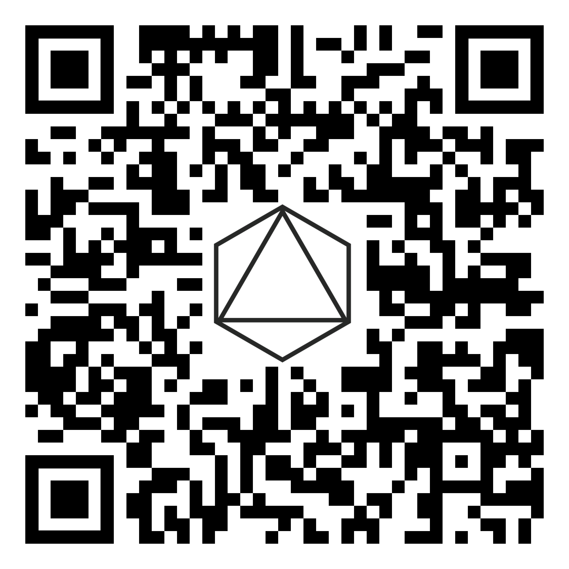
Stay Informed!
Website: activatecenter.org/
LinkedIn: linkedin.com/company/activate-collective
Subscribe to the Activate newsletter

Slide 39
Thank you!
For more information, contact
Activate at activate@childtrends.org
Or
Jan DeCoursey, Project Director, at Jdecoursey@childtrends.org
This project is supported by the Office of Population Affairs of the U.S. Department of Health and Human Services (HHS) as part of a financial assistance award totaling $3,384,000 with 100 percent funded by OPA/OASH/HHS. The contents are those of the author(s) and do not necessarily represent the official views of, nor an endorsement by, OPA/OASH/HHS or the U.S. government. For more information, please visit https://opa.hhs.gov.

Slide 40
Thank you for joining us today!
There is a brief survey after the end of this webinar.
Thank you for providing us feedback by completing this survey.
Webinar will be available in 3 days:
http://www.dibbleinstitute.org/webinar-archives/
Questions? RelationshipSkills@Dibbleinstitute.org

Slide 41
Scholarships are now available for professionals affected by the pandemic! For a limited time only, you can apply to receive the full Mind Matters Now series for free.
Find out more at:
www.dibbleinstitute.org/mind-matters-now-ce/
Questions? Esther@Dibbleinstitute.org

Slide 42
Get Continuing Education Credit
Dibble is now offering continuing education credits for a select series of free webinars. Now you can get credit for Violence Prevention and Trauma-Informed Webinars at:
https://www.dibbleinstitute.org/ceus/
Questions? Esther@Dibbleinstitute.org

Slide 43
Stay in Touch!
www.DibbleInstitute.org
Subscribe to our newsletter
Like us on FaceBook
Follow us on LinkedIn
RelationshipSkills@dibbleinstitute.org
800-695-7975

Slide 44
January 2025 Webinar
Sexual Cyberbullying & Healthy Romantic Relationships: Activate’s Sexual and Reproductive Health Resources
Presenters:
Rachel Rosenberg, Ph.D., Samuel Beckwith, Ph.D. and Karlee Naylon
Child Trends

